Slide 1
Score Predictor
RUBEN GHANDILYAN
MHER VAHRAMYAN

Slide 2
Two Methods
xG Based
Our Algorithm
Using Live data
Used Selenium to scrape data
Get the prediction for already finished games
Used Scrapy to get historical data

Slide 3
xG Based
xG is the amount of expected goals for a team in a match that is calculated by advance algorithms
We took the data and rounded the average of each teams score to get the final score

Slide 4


Our Algorithm
Defense Score
Attack Score
Initially we take these data from last year
Update the values for a team after each game
Predict the scores of upcoming matches

Slide 5
Our Algorithm
Coefficients
Goal Intervals
Game Importance Coeff
League Difference Coeff

Slide 6
Our Algorithm
Testing
One Score Correct
Exact Score Correct

Slide 7
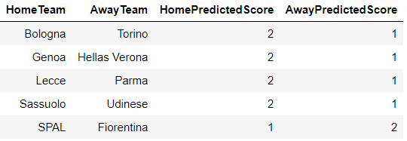
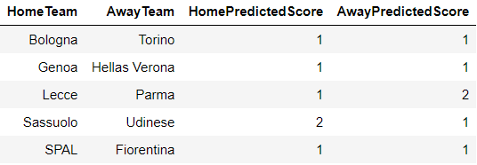
Results
Xg
Our Algorithm

Slide 8
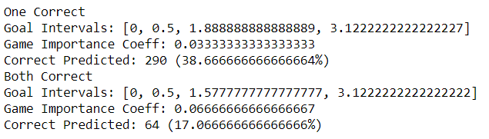
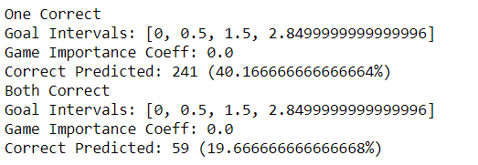
Results
Italy
England

Slide 9
>17% Exact score >38% One Score

Slide 10
Thank you!

